Slide 1
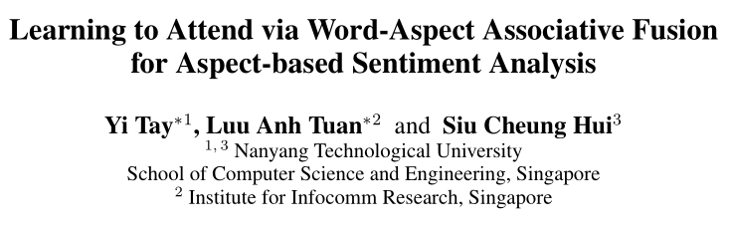
AAAI 2018

Slide 2
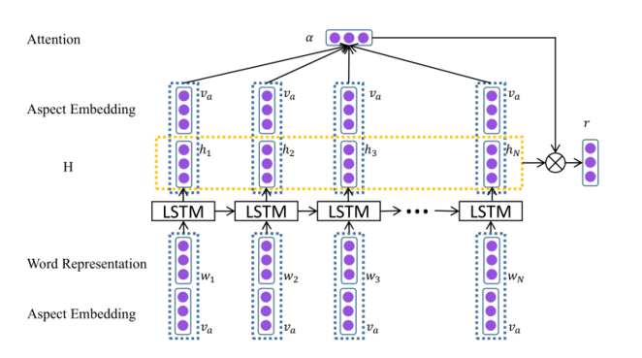
ATAE-LSTM

Slide 3
Instead of allowing the attention layer to focus on learning the relative importance of context words, the attention layer is given the extra burden of modeling the relationship between aspect and context words.

Slide 4
The parameters of LSTM are now given an extra burden aside from modeling sequential information, i.e., it has to also learn relationships between aspect and words. The LSTM layer in ATAE-LSTM is being trained on a sequence that is dominated by the aspect embedding. As such, this would make the model significantly harder to train.

Slide 5
Naive concatenation doubles the input to the LSTM layer
in ATAE-LSTM which incurs additional parameter costs
to the LSTM layer. This has implications in terms of memory footprint, computational complexity and risk of overfitting.

Slide 6
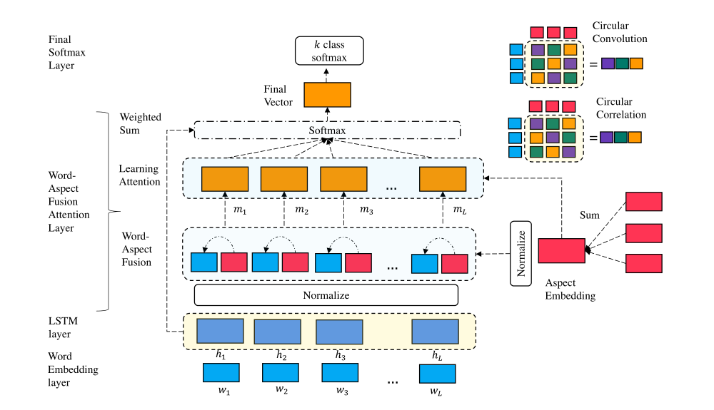
AF-LSTM

Slide 7
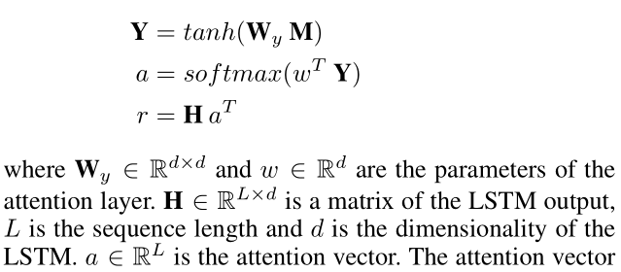

Slide 8
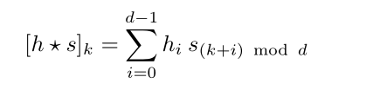



Slide 9
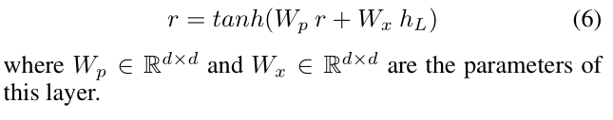

Slide 10
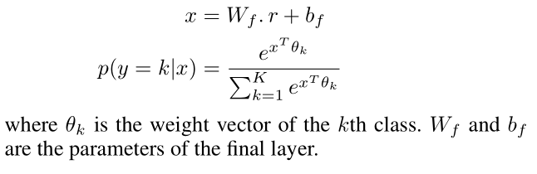
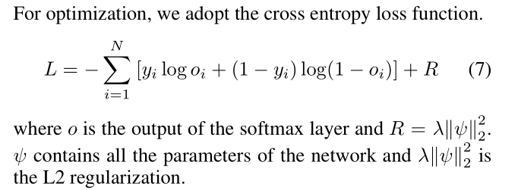

Slide 11
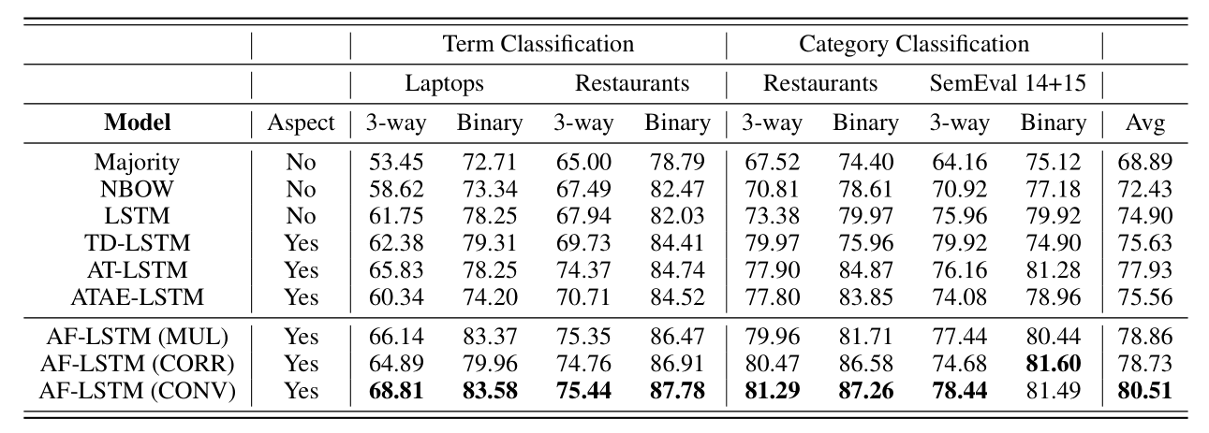

Slide 12
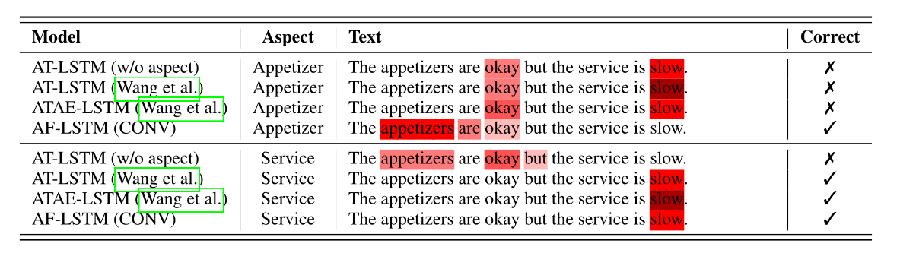

Slide 13
Thanks！
Notes:
Thank you

